Slide 1


GREEN UNIVERSITY OF BANGLADESH
Ride Sharing System
Presented by: Presented to:
Abir Al Anan - 222902035
Md. Solaiman Mia
Lecturer Dept. Of CSE
Green University Of Bangladesh
Md. Zehadul Islam - 222902069
01

Slide 2
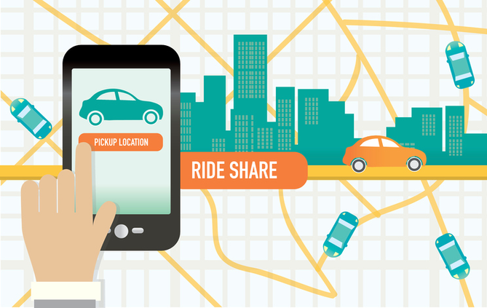
Introduction
Comprehensive Ride-Sharing Simulation
Shell Based Interface
Practical Learning Experience
02

Slide 3


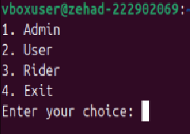


Methodology
Admin Feature
Structure
User Features
Rider Features
04

Slide 4

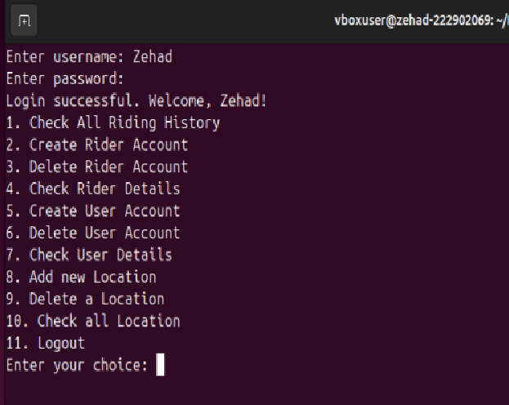
Admin Features
When you select option 1 then :
Logging will happen after successful admin pass and username.
05

Slide 5
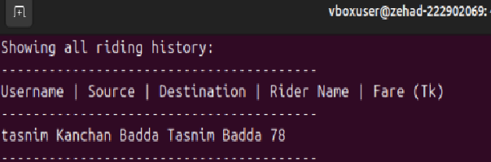

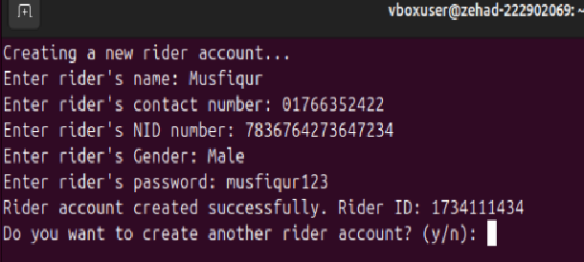
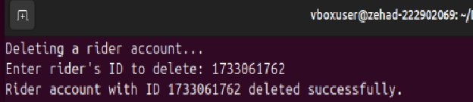
Admin Features
Check All Riding History
2. Create Rider Account
3. Delete Rider Account
06

Slide 6
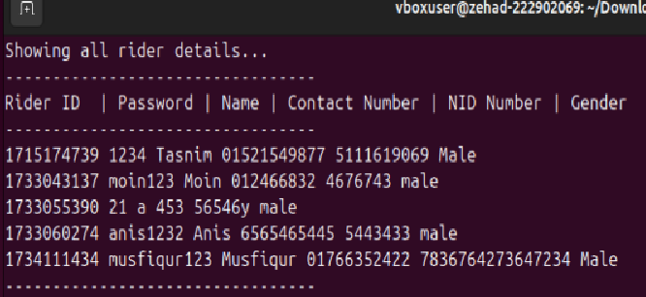
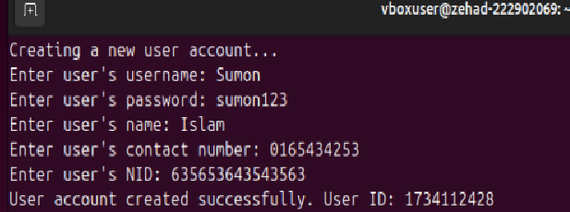
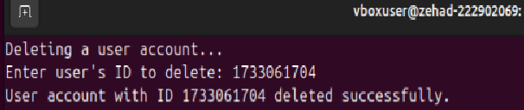
Admin Features
4. Check Rider Details
5. Create User Account
6. Delete User Account
07

Slide 7
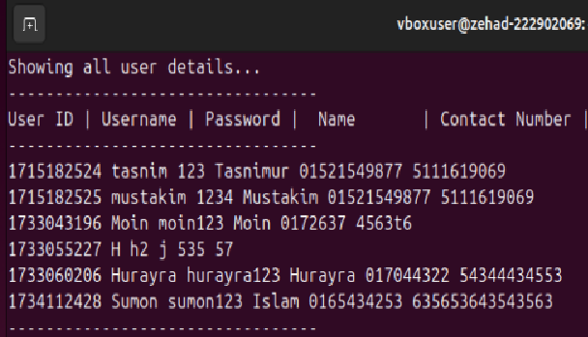
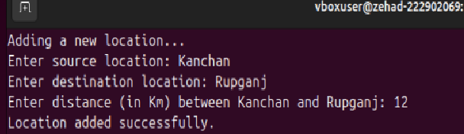
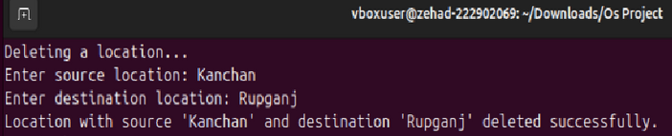
Admin Features
7. Check User Details
8. Add new Location
9. Delete a Location
08

Slide 8
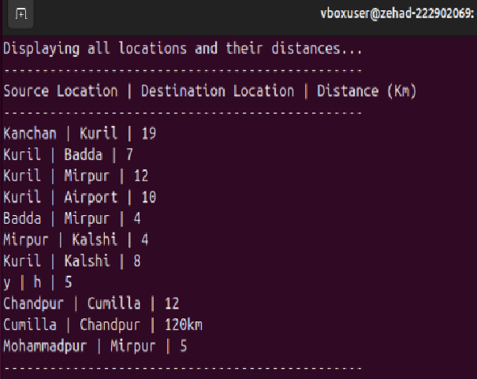
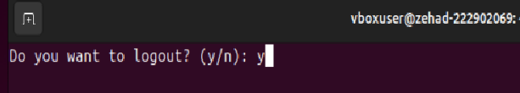
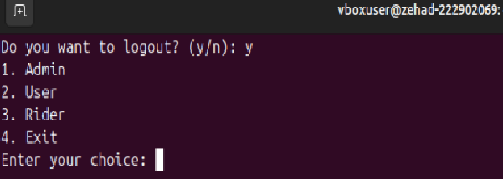
Admin Features
10. Check All Location
11. Logout and return homepage
09

Slide 9
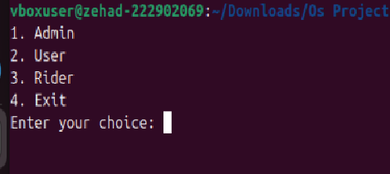
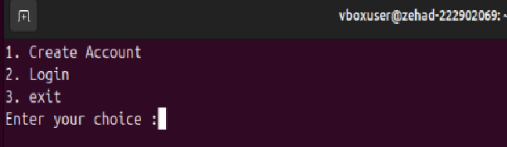
User Features
When you select option 2 then :
Now, there will be 3 options. If the account is created then I will not log in or create new logging.
10

Slide 10

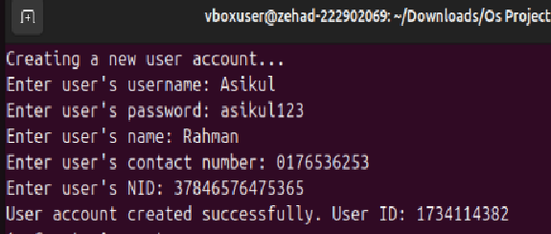
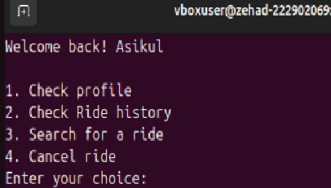
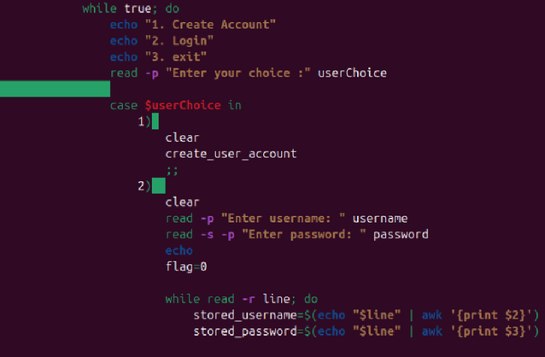

User Features
Create Account
2. Login
11

Slide 11
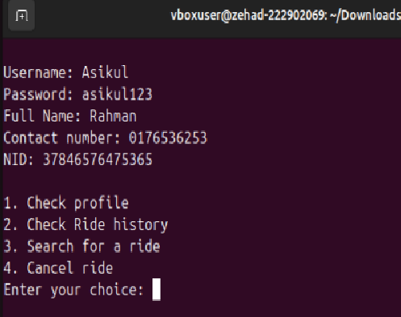
User Login Features
User Options After Login Perfectly : There will be 4 options.
12

Slide 12

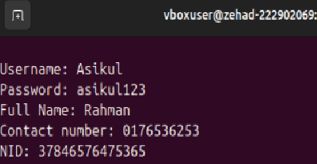
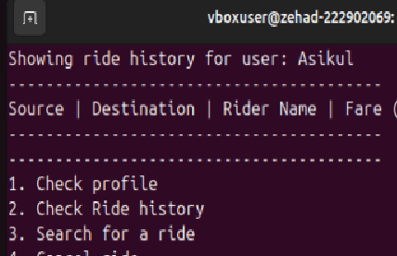
User Features
Check Profile
2. Check Ride History
13

Slide 13
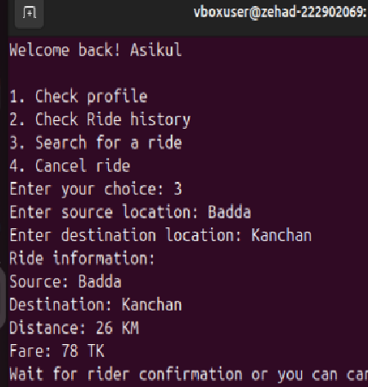
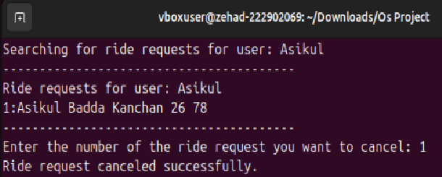
User Features
3. Search and order for a Rider
4. Cancel Rider
14

Slide 14
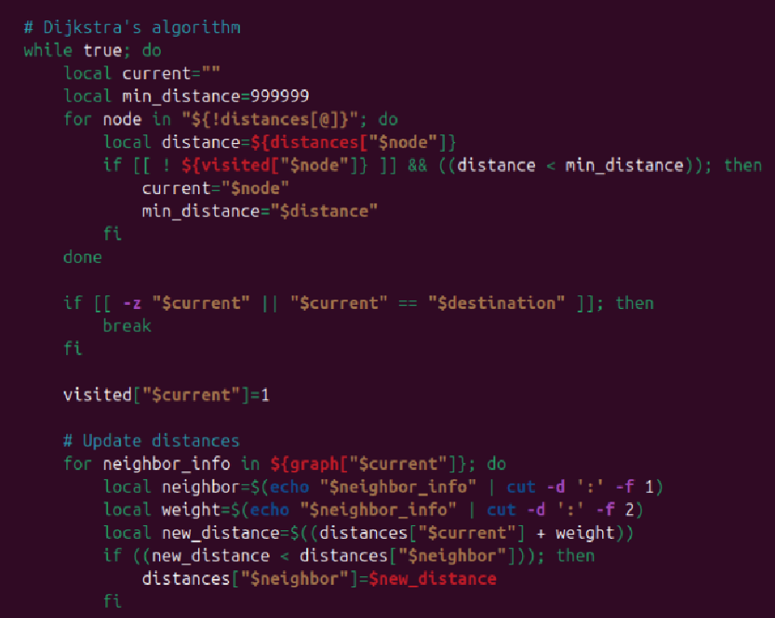
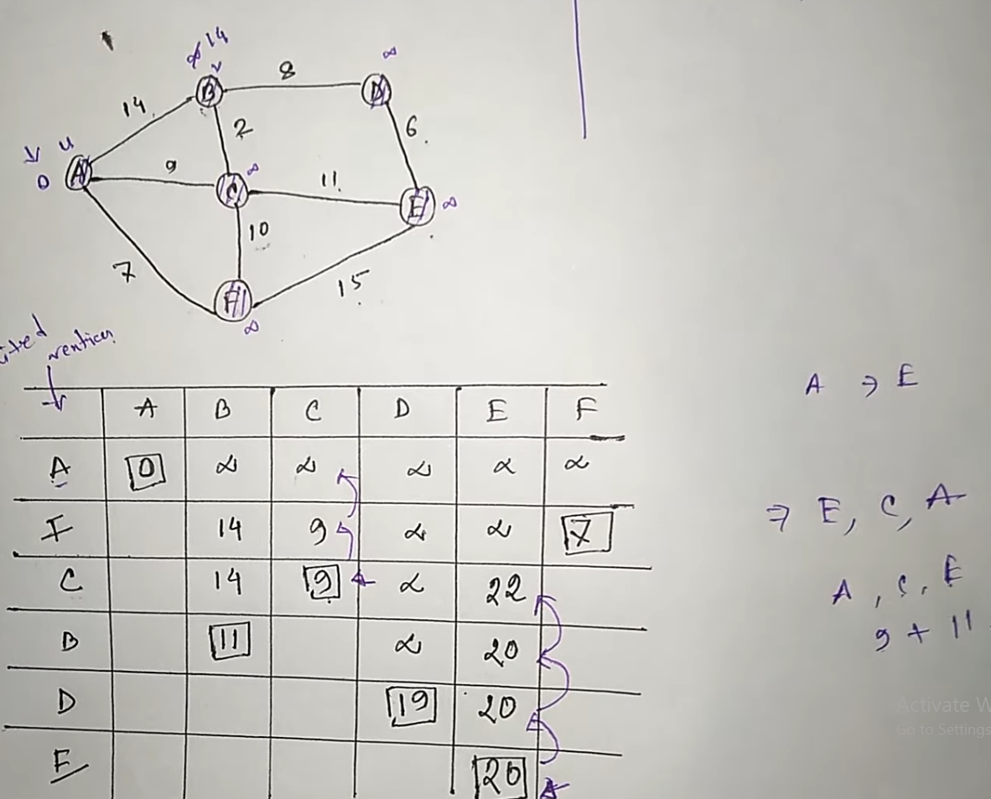
TOOLS & TECHNOLOGIES
BASH SCRIPTING
DIJKSTRA’S ALGORITHM
COMMAND-LINE INTERFACE
03

Slide 15
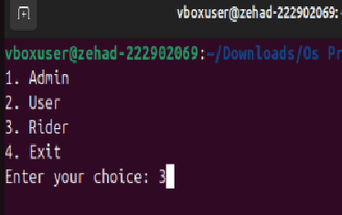
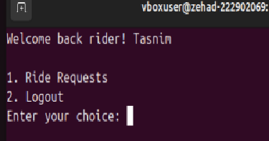
Ride Features
After the ride option is gone, we will have two options to work with. One is that maybe the request will be accepted or cancelled . Then I will do logout.
15

Slide 16
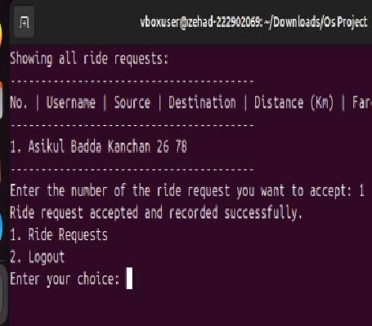
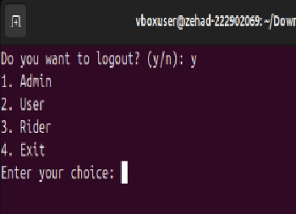
Ride Features
1.Ride Requests accept and recorded successfully
2. Rider account Logout
16

Slide 17
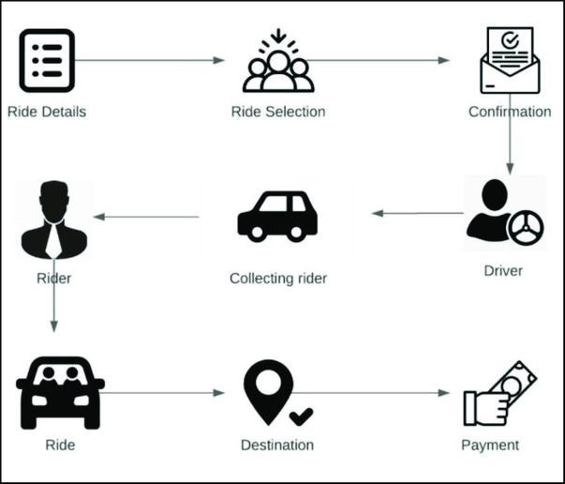
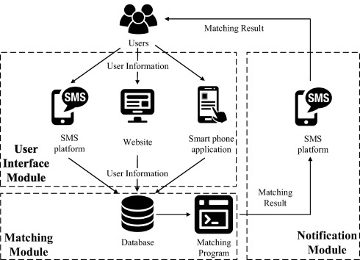
Ride Management System Overview
Admin Manage
Ride
User
17

Slide 18

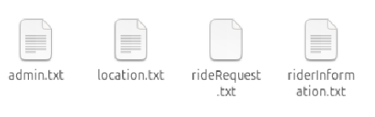

Technology Stack
File: User and ride information storage
18

Slide 19
Future Scope
Advanced features or tools can be added to enhance functionality and improve efficiency for future tasks.
The project framework can be adapted for similar applications, making future developments faster and more resource-efficient.
19

Slide 20

Conclusion
The project provides an efficient system for managing users and rides. It ensures smooth communication, easy ride selection, and proper coordination between users, drivers, and the admin, making the process more organized, reliable, and user-friendly for all involved.
20

Slide 21
Thank You
21

